Slide 1
THE ROLE OF oneM2M in UNLOCKING the IOT potential
Presenter: Omar Elloumi, oneM2M TP Chair, Nokia Bell-Labs and CTO group
omar.elloumi@nokia.com
oneM2M www.oneM2M.org
Notes:
Other suggested titles:
“Benefits of oneM2M Standardization”

Slide 2
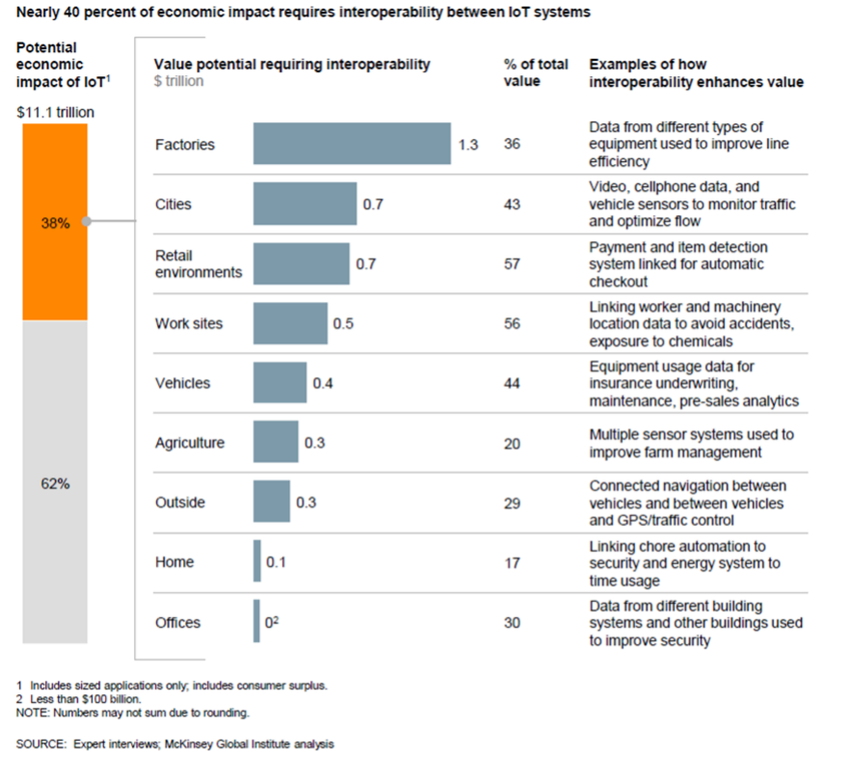
Nearly 40% of economic impact requires interoperability between IoT systems
Source: McKinsey

Slide 3













oneM2M Partnership Project
Over 200 member organizations in oneM2M
www.oneM2M.org
All document are publically available

Slide 4
Work Process
Energy
Enterprise
Healthcare
Public Services
Residential
Other
Transportation
Industry
REQUIREMENTS
TS-0002
TECHNICAL REPORTS
TECHNICAL SPECS

Slide 5










Ongoing collaborations
Guidelines
& Ref. Arch.
P2413
collaborations
Now OCF
MQTT
uses
interworks with
Interoperability standards
OMADM LWM2M
Uses/interworks
uses
interworks with
HTTP CoAP TLS DTLS
Protocols
Platforms

Slide 6




















Strong implementation base
  Industry-driven Open source implementations
  Examples of Commercial implementations /demos
  4 interop. events so far
IotDM

Slide 7
M2M Common Service Layer in a nutshell
A software “framework”
Located between the M2M applications and
communication HW/SW that provide connectivity
Provides functions that M2M applications
across different industry segments commonly need
(eg. data transport, security/encryption, remote software update...)
Like an “Android” for the Internet of Things
But it sits both on the field devices/sensors and in servers
And it is a standard – not controlled by a single private company

Slide 8
oneM2M Architecture approach
Pipe (vertical):
1 Application, 1 NW,
1 (or few) type of Device
Point to point communications
Horizontal (based on common Layer)
Applications share common service and network infrastructure
Multipoint communications
Application
Application
Application
Application
Business
Application
Common Service Layer
Common
Service Layer
Communication
Network (wireline, wireless, Powerline ..)
Communication
Network 1
Communication
Network 2
Things representations (including semantics)
IP
Gateway
S
Gateway
Local NW
Device
A
Device
Local NW
A
S
A
Device
Device
S
A
A
Device
A
Things
S
Common Service Layer
A
Application

Slide 9
Architecture
Reference Point One or more interfaces - Mca, Mcn, Mcc and Mcc’ (between 2 service providers)
Common Services Entity Provides the set of "service functions" that are common to the M2M environments
Application Entity Provides application logic for the end-to-end M2M solutions
Network Services Entity Provides services to the CSEs besides the pure data transport
Node Logical equivalent of a physical (or possibly virtualized, especially on the server side) device
Application
Layer
AE
AE
AE
Mca
Mca
Mca
Service
Layer
CSE
CSE
CSE
CSE
Mcn
Mcc
Mcn
Mcn
Mcc
Mcn
Mcc’
Underlying
Network
Underlying
Network
Network
Layer
NSE
NSE
NSE
NSE
Application Service Node
Middle Node
Infrastructure Node
Inf. Node

Slide 10
Common Service Functions
Registration
Discovery
Security
Group Management
Data Management & Repository
Subscription & Notification
Device Management
Application & Service Management
Communication Management
Network Service Exposure
Location
Service Charging & Accounting

Slide 11
oneM2M release 2 features
Home domain enablement
  Home appliance information models
  ontologies and mapping to existing standards
Industrial domain enablement
  “Real-time” data collection
  redundancy and fault tolerance
  enablers for analytics
Application developer APIs and guidelines
oneM2M
Beyond
initial release
oneM2M as generic interworking framework
  AllJoyn/AllSeen
  OIC
  LightWeight M2M (LWM2M)
Semantic interoperability
  base ontology, link to domain specific ontologies
  semantic descriptions
  semantic discovery
Dynamic authorizations and end to end security
  device onboarding and provisioning

Slide 12
Why oneM2M? why now?

Slide 13
Why oneM2M? Why now?
M2M (and IoT) communications existed for so many years, e.g.:
  SCADA systems
  Satellite based truck tracking
So why oneM2M?
  Specific standards exist for home automation, smart factory, energy management, etc. but a large growth will come from a fully integrated Internet of Things
  The IoT vision will not materialize if we do not solve interoperability issues, therefore drive down integration costs and ensure time to market
Why now?
  Technology is ready for an outcome based economy for a large number of use cases, more that what one can think of

Slide 14











Technology 1: connectivity, plenty to chose from
Range (extended)
Native Low Power
Wide-area Access
NB-IoT, LTE-M, etc.
3GPP Cellular
(GSM/LTE)
Device cost (low)
Bitrate (low)
Device cost (high)
Bitrate (high)
WPAN
(e.g. 802.15.4, DECT ULE)
WLAN
(e.g. 802.11)
Range (low)
Source AIOTI, modified from an ALU contribution

Slide 15
Technology 2: horizontalization
«building IoT in Siloes belongs to the past »
NICHE VERTICALS
Low volumes, high ARPC, high TCO
BROAD ADOPTION
High volume, low ARPC, low TCO
Devices and Applications are designed as “stove-pipes”
Devices dedicated for single application use
Solutions are closed and not scalable: duplication of dedicated infrastructure
High development & delivery cost
Devices and Applications are designed to collaborate across “clouds”
Devices are used for multiple application purposes
Devices and Applications offering continuously evolve
Easy app development and device integra-tion through APIs and standard interfaces
Horizontal platform with common functions and interfaces
Source: Alcatel-Lucent

Slide 16
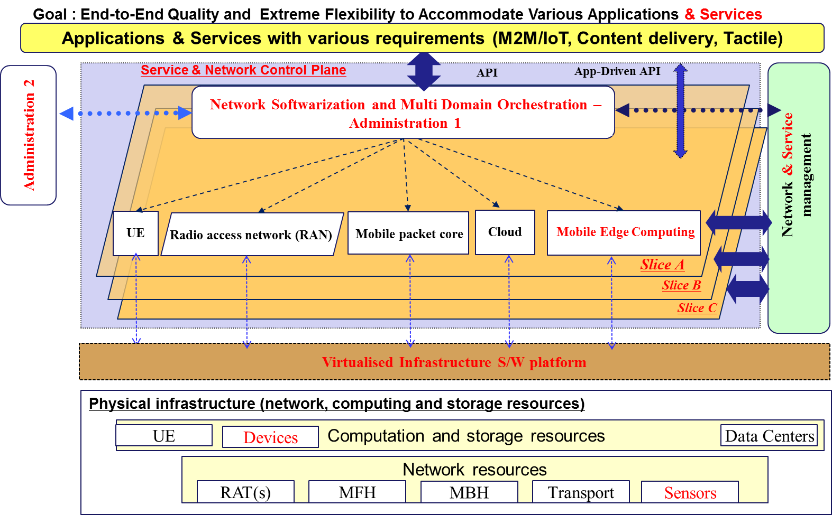
Technology 3: softwarization and IoT virtualization
Source: ITU-T Focus Group IMT2020

Slide 17








Technology 4: Semantic interoperability, no longer a research syndrome?
Sent packages
are tracked on
the web
Plants action
a tap to water themselves.
Take the world
online
Let the things
talk to each others
Communication
Interoperability
Semantic
Reasoning
Data
Interoperability
Brochure
web site
Take the control
of the world
Let Things become
intelligent
All monuments
are described on
the web.
Monitor and control home appliances.
Alarm ring earlier
in case of traffic or bad weather.
17
Source: sensinov

Slide 18
EXAMPLE : ROLE OF ONEM2M IN SMART CITIES

Slide 19
Key findings/trends
«City 2.0»
Smart city platforms bring significant efficiencies when the number of applications grows
  Shared data
  Single API set and data formats are beneficial for developers
Initial cost of platform investment tends to be marginal compared to economies of scale, OPEX options can alleviate initial costs
Connectivity, plenty to chose from
Machine learning and analytics create great benefits (e.g. traffic management, parking management)
Living labs for research and innovation
Open standards are crucial for sustainable success

Slide 20
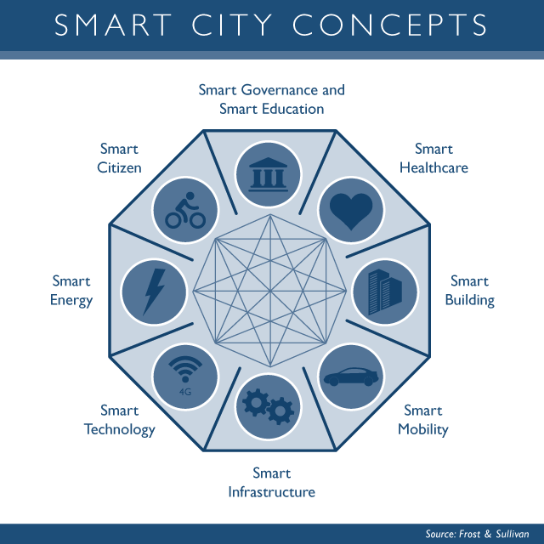
Vision for building smart cities
2. Digitalize and «sensorise»
1. Build a vision
3. Build Dashboards
4. Expand the vision, Integrate and Innovate
Source: Based on discussions with Dr. Martin Serrano,
OASC and Insight centre

Slide 21
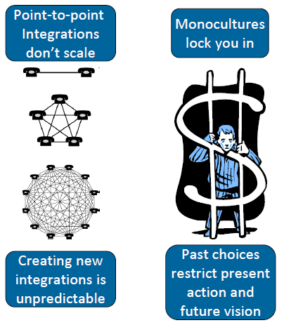
Integration challenge
Automotive
Home
Energy
Health
Energy
Applications
Home
Applications
Automotive
Applications
e-Health
Applications
Common Service Layer
Communication Devices & Hardware
Communication Technologies & Protocols
Communication Networks
Platform based integration
Based on open standards
Source: CRYSTAL project/Philips

Slide 22
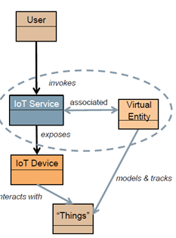
Semantic interop challenge
things
Common Service layer
Things representation
Source: AIOTI
represents
Data (e.g. temperature)
ontology
Metadata
Semantic description
instantiates
Other metada (e.g. digital right management and privacy related)
Discovery – Consistency – Scalability - Efficiency

Slide 23
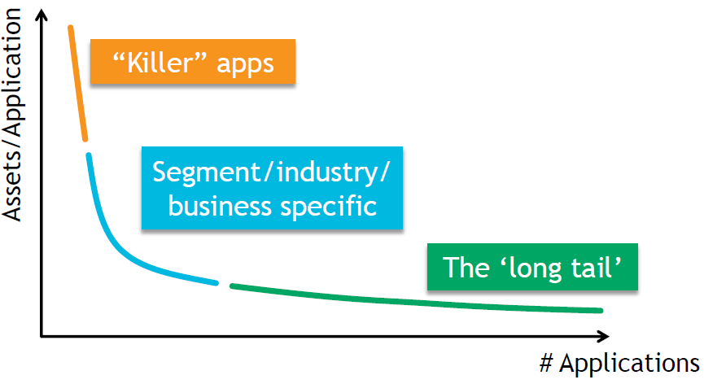
Innovation challenge
App developers focus on app logic: use of Restful APIs
Hide WAN and Area Network technologies specificities (interworking exposed as a service by the platform)
Free access to city open data
  Controlled access to other data
How do I address
the needs of app developers

Slide 24
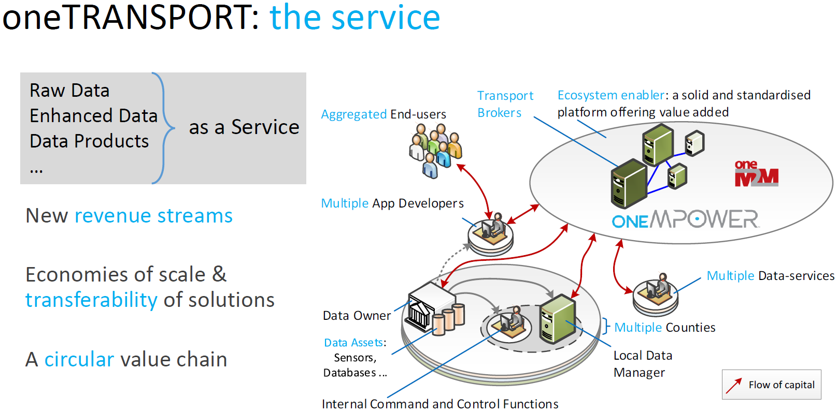
oneTransport
Source: Interdigital

Slide 25
Key requirements for smart city IoT platform
Horizontal platform for new deployments
Smart city is an incremental and participatory journey
New deployments should, where possible, leverage a converged networks and an horizontal service platform
Open standards are key to avoid lock-in and master the total cost of ownership
Existing deployments
Do not disrupt existing “vertical deployment” but seek opportunities for an integration path with an horizontal approach
Build value through smash-ups and open data
Participatory and innovative approach
Surveys
Address needs for innovation through app development:
  APIs
  Access to, eventually semantically enriched, Open data (where feasible and subject to privacy legislation/citizen consent)
Security and (device) management are key
Despite initial focus on IoT data, there is an increased interest in security and device management (which go hand in hand).
Need arises from security threat analysis conducted recently: e.g. ”Two researchers analyzed Smart meters widely used in Spain and discovered that can be hacked by attackers to harm the overall National power network.”, source: http://securityaffairs.co/wordpress/29353/security/smart-meters-hacking.html

Slide 26
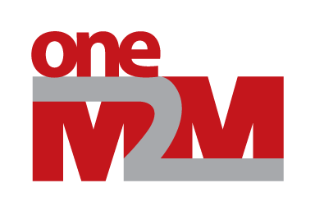










A possible smart city blue-print
Cloud apps
Dashboards
City Apps
3rd party apps
Analytics apps
Dashboards
City Apps
3rd party apps
Analytics apps
REST
APIs
REST
APIs
SPARQL or
REST APIs
Smart city backend
Open data
(Semantics)
Group mgmt
Data
Mgmt
Cloud
VM Mgmt
Location
Big Data Storage
Big Data enablers
Broker
Other data
sources
I/F to other
IoT platforms
Discovery
Adapter
Existing
deployments
Device
Interworking
Adapter
Smart city frontend
Security
App
App
App
Data center
Device mgmt
Field domain
Gateway
Gateway
Device
D
D
D
D
D
D
D
D
D
LWM2M

Slide 27
Design Principles
Frontend/backend scale differently.
Frontend designed for massive secure connections to devices/apps, dev mgmt, interworking, protocol adaption
Backend about data functions: replication, anonymization, VM management, availability, horizontal scalability, no single point of failure, etc.
Semantic engine is about metadata to enrich data sets, reasoning: fast track for integration and analytics
Build value for existing application through adapters
Open APIs and open data are key for innovation
I/F to other platforms: utility, automotive (autonomous driving), etc.

Slide 28
Take away

Slide 29
Summary of Release 3 Features
Smart City and Automotive Enablement
  Service Continuity
  Cross resource subscriptions
Industrial Domain Enablement
  Atomic Transactions
  Action Triggering
  Optimized Group Operations
Market Adoption
  Developer Guides
  oneM2M Conformance Test
  Feature Catalogues
  Product Profiles
Management
  M2M Application & Field Domain
  Component Configuration
oneM2M
Rel-3
Features
Semantics
  Semantic Querying
  Semantic Mashups
  oneM2M Ontology Enhancements
oneM2M Interworking
  3GPP SCEF
  OMA LWM2M
  DDS
  OPC-UA
  Modbus
  Proximal IoT
  OSGi
  W3C WoT
Security
  Enrollment & Authentication APIs
  Distributed Authorization
  Decentralized Authentication
  Interoperable Privacy Profiles
  Secure Environment Abstraction

Slide 30
Take-away
Open standards to avoid lock-in to a platform or a cloud provider
  It is also a matter of national sovereignty
Multiple standards exist for connectivity/proximity networks and specific vertical
  Therefore one need to be careful when comparing standards
  From this perspective oneM2M is the only standard that addresses cross domain and cloud wide IoT data communications, it is also applicable for device and gateway nodes
Another challenge is making the platform cloud native
  This is one area of differentiation
  Cloud native means: High throughput, low latency, no single point of failure, horizontal scalability, micro services, DevOps, multitenancy, no dependency on a specific cloud provider, etc.
The debate about which platform standards is largely distracting the stakeholders from the real value of IoT: data
  Cloud native IoT along with REST APIs help in building a data economy

Slide 31
